Slide 1

LCR Visioning
Core Values and Mission Statement
Notes:
Welcome
Introductions (if needed)
Logistics (bathroom, breaks, etc. if needed)

Slide 2
Visioning Process Year 1
Discovery Process: Survey (Completed)
Develop Core Values and Mission Statement (Current)
Develop Vision and Strategy (September)
Notes:
This is a 3 year process and we are in the first year
The key steps for the first year are:
Discovery Process – We completed this process. This was the Survey that the congregation completed, the demographic study and feedback from Racine area leaders. We will review key learnings from this process on the next slide.
Develop Core Values and Mission Statement. This is the step we are working on today
Develop Vision and Strategy (starting in September)

Slide 3
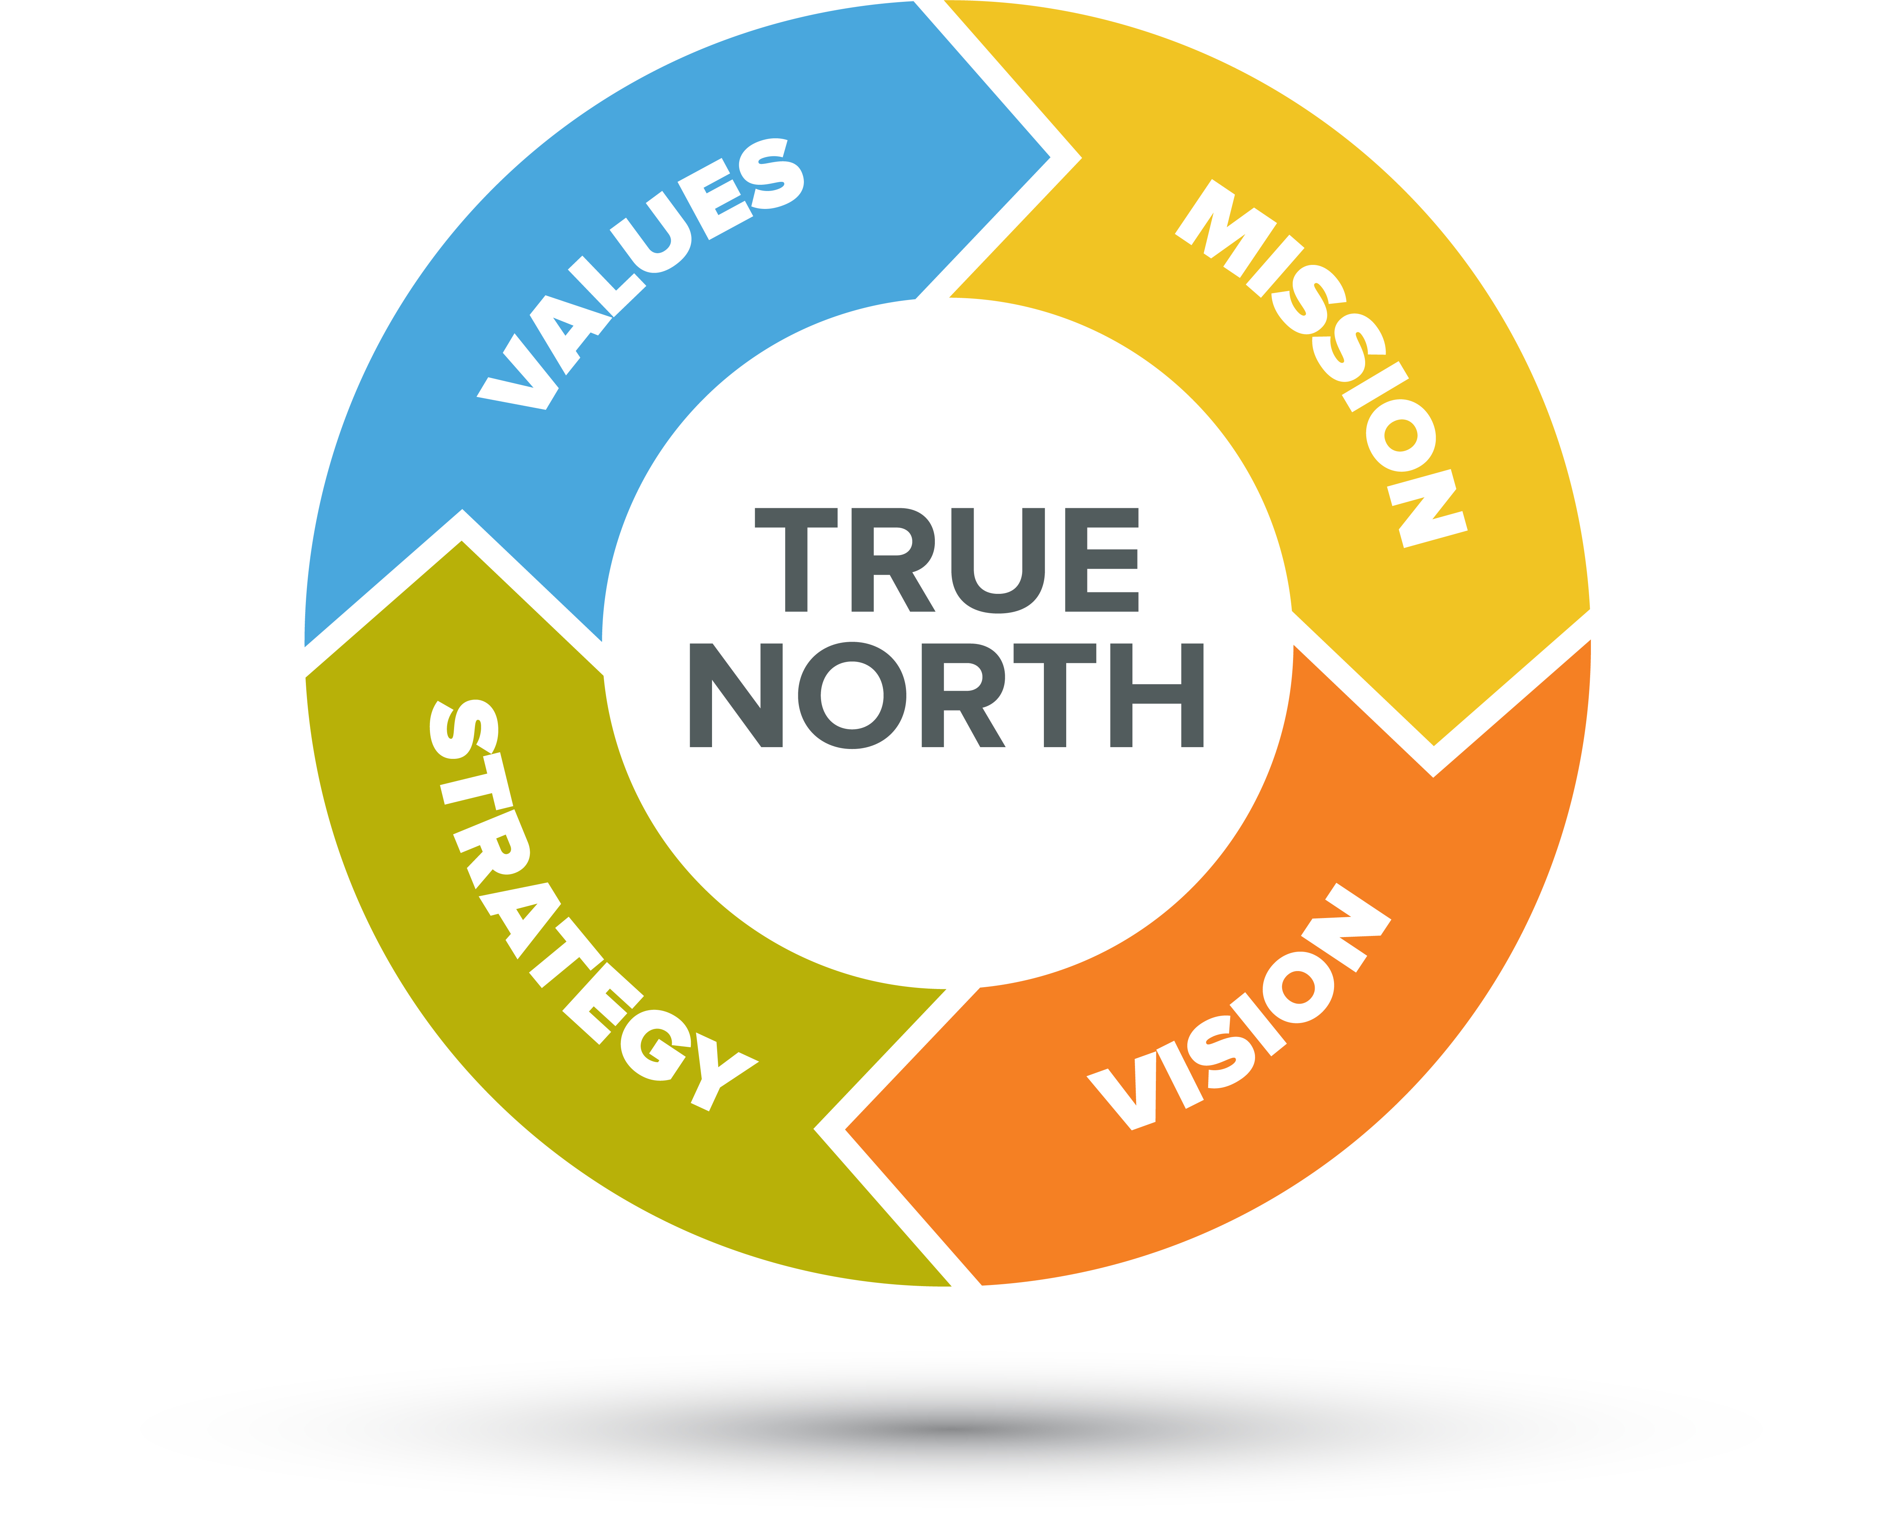
The First Year Visioning Goal:
Determine LCR’s True North
Currently working on Values and Mission
Notes:
The overall visioning goal is Alignment to True North. What direction do we want/need the church to go in for the future success. What is success? How will we make decisions to ensure we stay on course?
Everything must be in alignment with everything else

Slide 4
Today’s process…
Break into small groups with a facilitator
Brainstorm your ideas around our current core values
Align each small group on the 3-4 most important core values
BREAK OUT!!!
Notes:
This is our past and present, things that make us unique. Things that you are most proud about our church.

Slide 5

LCR Visioning
Small Group Breakout Exercise
Notes:
Welcome
Introductions (if needed)
Logistics (bathroom, breaks, etc. if needed)

Slide 6
NEXT STEPS
Combine all small group core values and mission statements and combine into a recommended result.
Present to LCR’s Visioning Taskforce and gain approval
Communicate to the congregation
Begin working on Strategy and Vision in September
Notes:
Next Step and THANK YOU!

